Slide 1
Universality and phase transitions

Slide 2
Mott transition

Slide 3
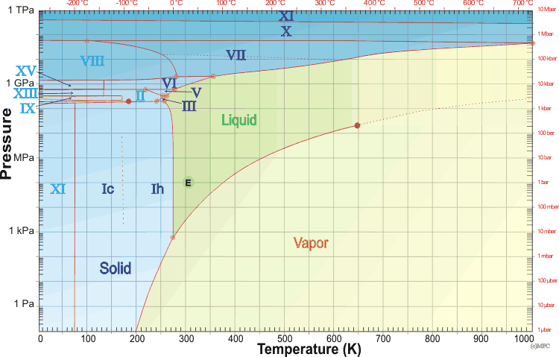
Phase diagram of water

Slide 4
Mott trans in (V_{1-x}Cr_{x})₂O₃
Limellette et al, Science 302, 89 (2003)

Slide 5
Conductivity jump
Limellette et al, Science 302, 89 (2003)

Slide 6
Critical behavior
Limellette et al, Science 302, 89 (2003)

Slide 7
Quantum criticality…

Slide 8
Quantum criticality in CeCu_{6-x}Au_{x}
Scröder et al, Nature 407, 351 (2000)

Slide 9
Quantum criticality in high T_{C}
Orenstein and Millis, Science 288, 468 (2000)

Slide 10
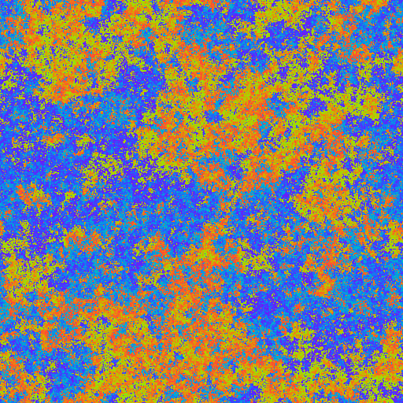
Criticlal state structure

